Slide 1

Array
  Group of variables (called elements) containing values of the same type.
  Arrays are objects so they are reference types.
  Elements can be either primitive or reference types.
Refer to a particular element in an array
  Use the element’s index.
  Array-access expression—the name of the array followed by the index of the particular element in square brackets, [].
The first element in every array has index zero.
The highest index in an array is one less than the number of elements in the array.
Array names follow the same conventions as other variable names.
© Copyright 1992-2015 by Pearson Education, Inc. All Rights Reserved.

Slide 2
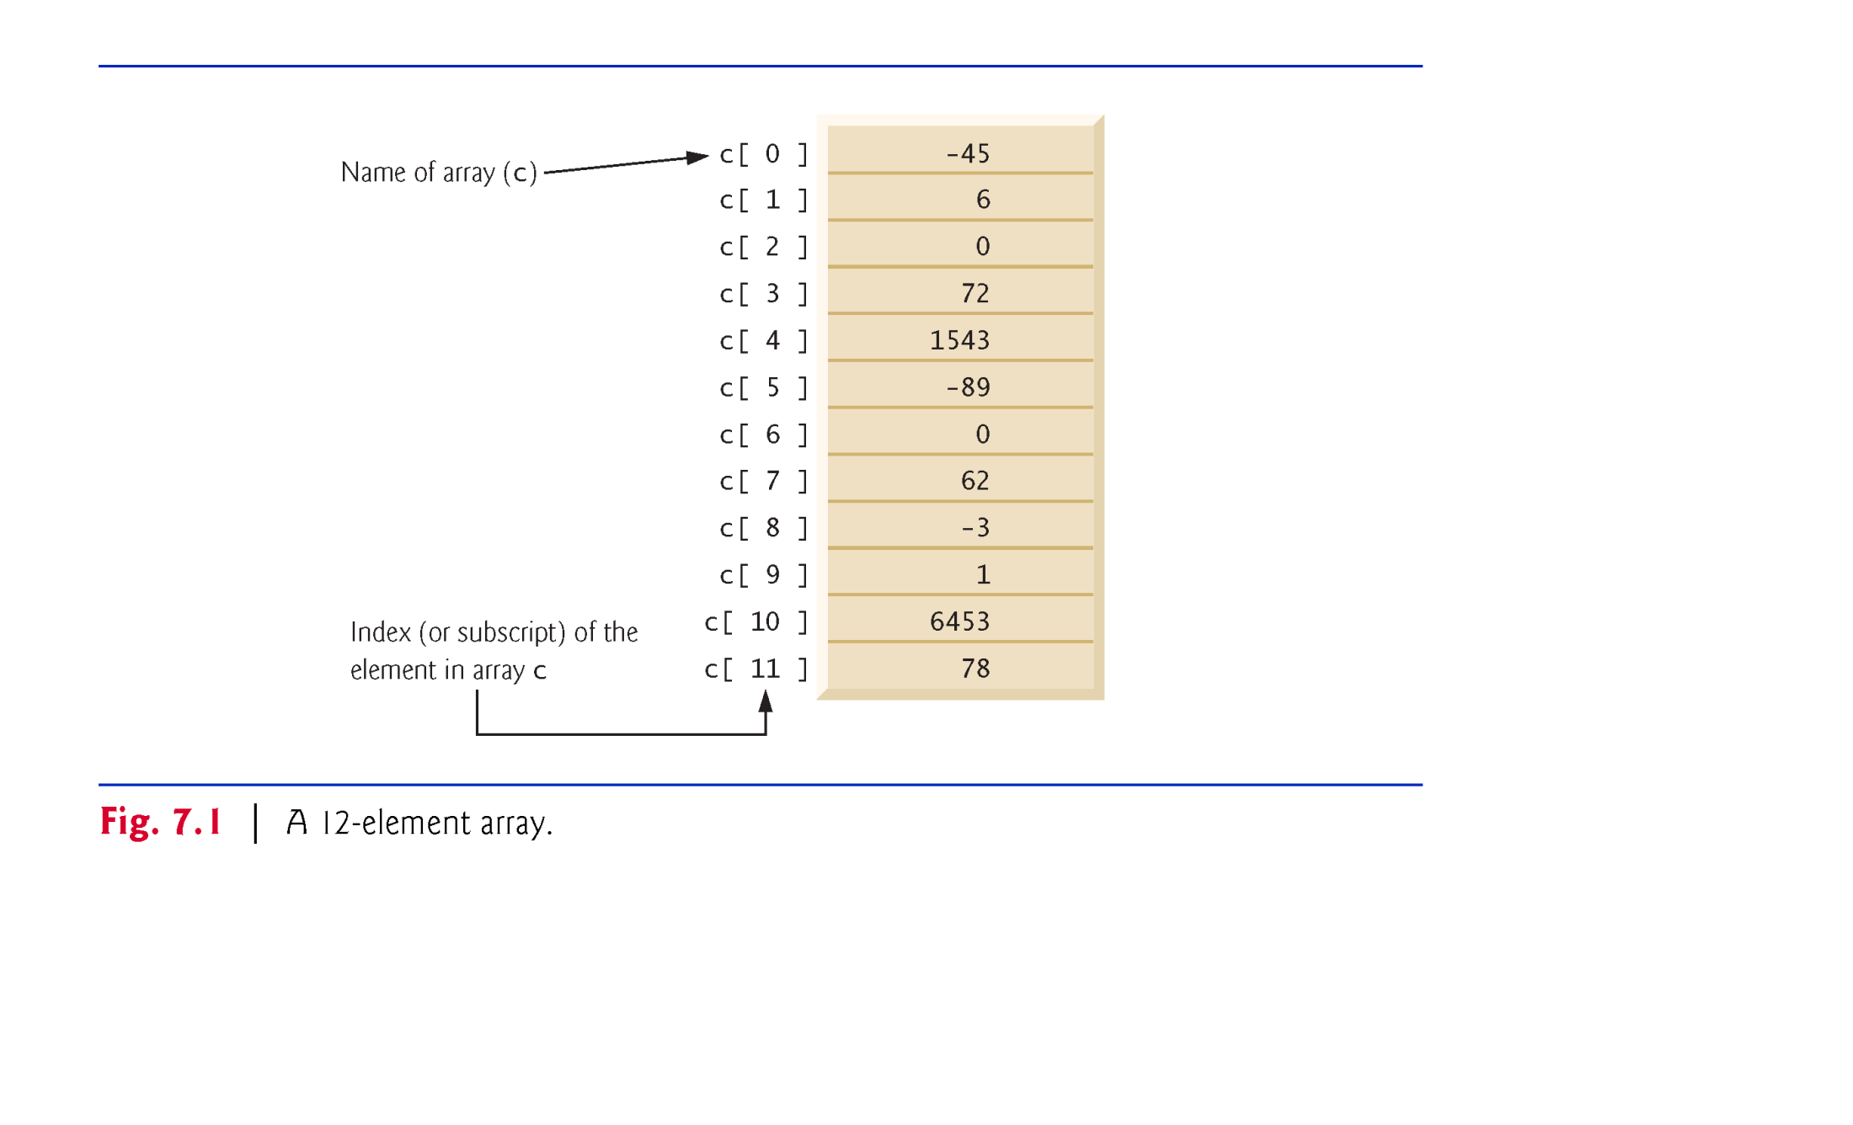
© Copyright 1992-2015 by Pearson Education, Inc. All Rights Reserved.

Slide 3

Array objects
  Created with keyword new.
  You specify the element type and the number of elements in an array-creation expression, which returns a reference that can be stored in an array variable.
Declaration and array-creation expression for an array of 12 int elements
    int[] c = new int[12];
Can be performed in two steps as follows:
    int[] c; // declare the array variable
    c = new int[12]; // creates the array
© Copyright 1992-2015 by Pearson Education, Inc. All Rights Reserved.

Slide 4
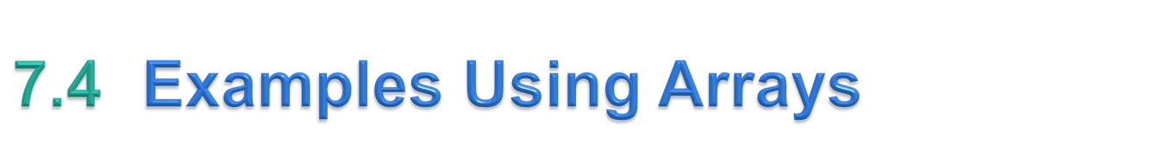
This section presents several examples that demonstrate declaring arrays, creating arrays, initializing arrays and manipulating array elements.
© Copyright 1992-2015 by Pearson Education, Inc. All Rights Reserved.

Slide 5
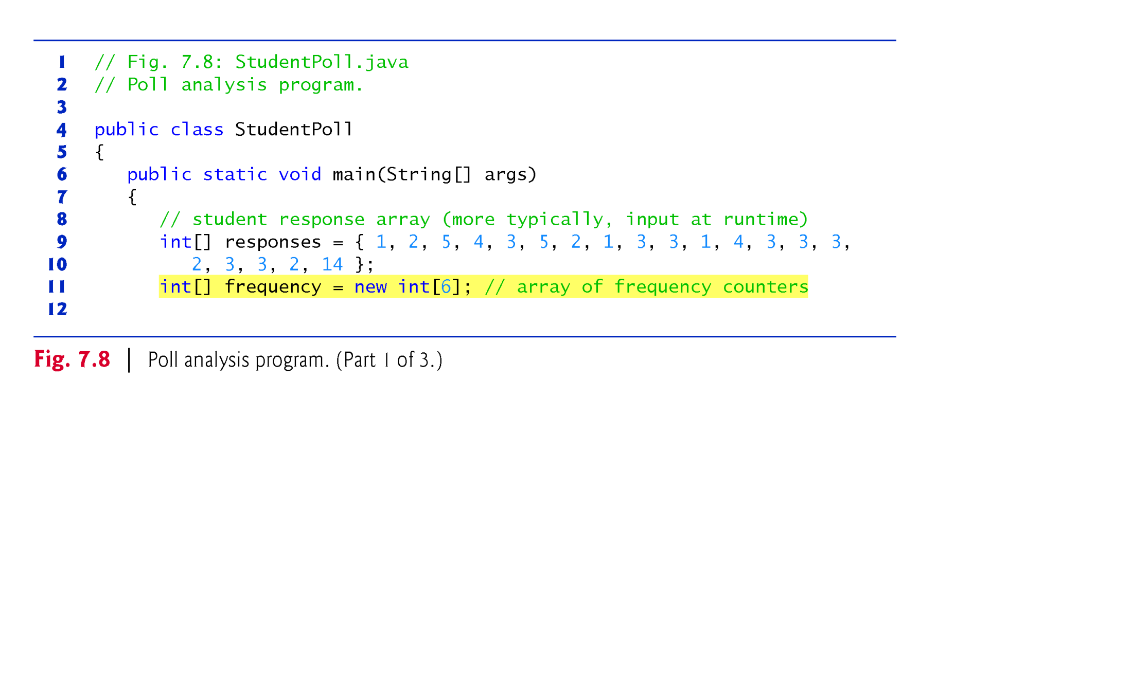
© Copyright 1992-2015 by Pearson Education, Inc. All Rights Reserved.

Slide 6
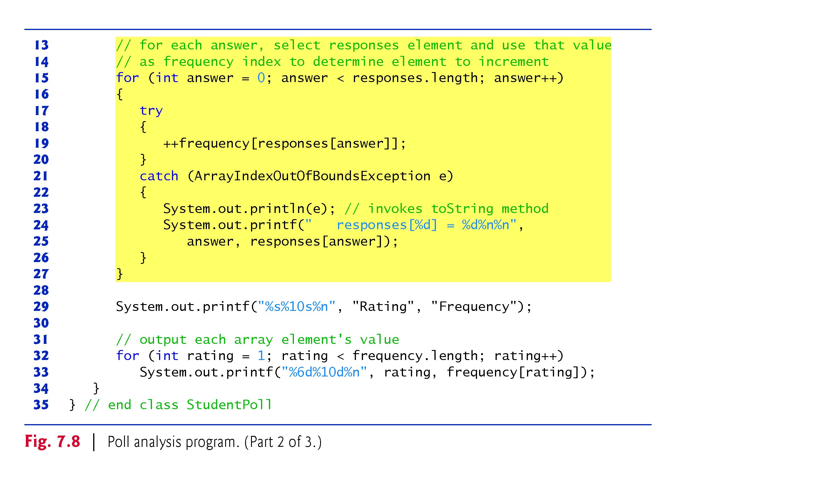
© Copyright 1992-2015 by Pearson Education, Inc. All Rights Reserved.

Slide 7
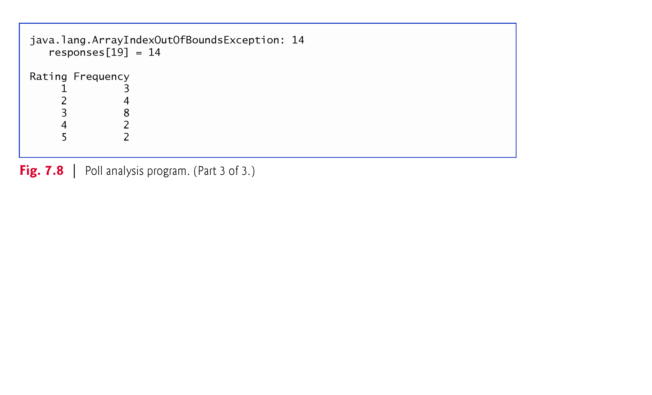
© Copyright 1992-2015 by Pearson Education, Inc. All Rights Reserved.

Slide 8
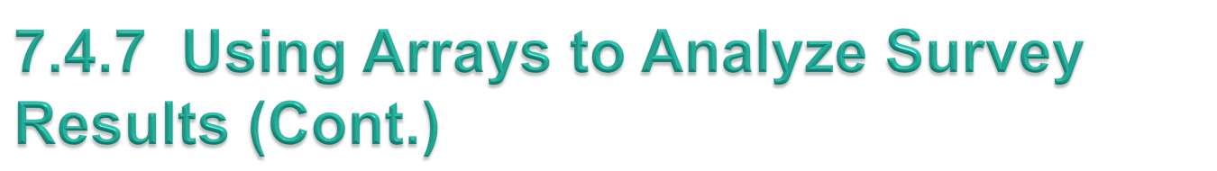
If a piece of data in the responses array is an invalid value, such as 14, the program attempts to add 1 to frequency[14], which is outside the bounds of the array.
  Java doesn’t allow this.
  JVM checks array indices to ensure that they are greater than or equal to 0 and less than the length of the array—this is called bounds checking.
  If a program uses an invalid index, Java generates a so-called exception to indicate that an error occurred in the program at execution time.
© Copyright 1992-2015 by Pearson Education, Inc. All Rights Reserved.

Slide 9

Enhanced for statement
  Iterates through the elements of an array without using a counter.
  Avoids the possibility of “stepping outside” the array.
  Also works with the Java API’s prebuilt collections (see Section 7.14).
Syntax:
    for (parameter : arrayName)
    statement
where parameter has a type and an identifier and arrayName is the array through which to iterate.
Parameter type must be consistent with the array’s element type.
The enhanced for statement simplifies the code for iterating through an array.
© Copyright 1992-2015 by Pearson Education, Inc. All Rights Reserved.

Slide 10
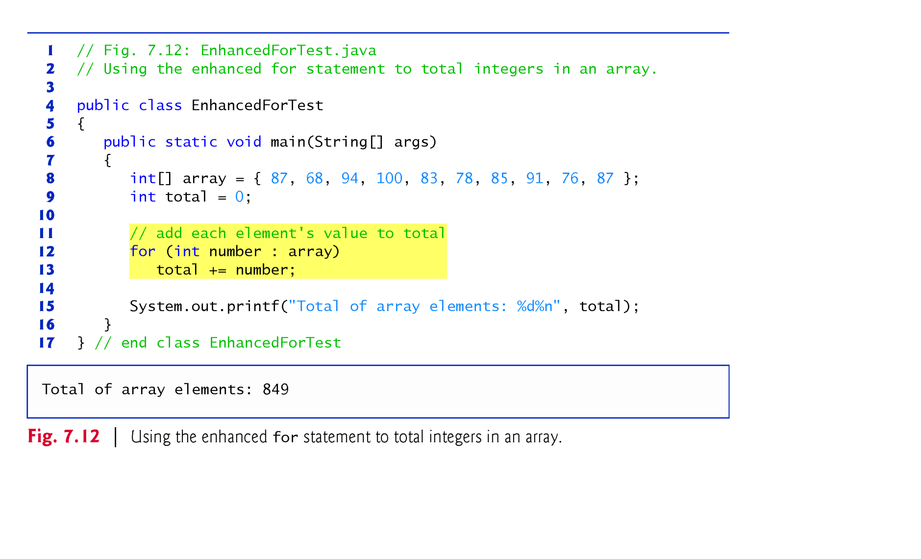
© Copyright 1992-2015 by Pearson Education, Inc. All Rights Reserved.

Slide 11

Arrays class
  Provides static methods for common array manipulations.
Methods include
  sort for sorting an array (ascending order by default)
  binarySearch for searching a sorted array
  equals for comparing arrays
  fill for placing values into an array.
Methods are overloaded for primitive-type arrays and for arrays of objects.
System class static arraycopy method
  Copies contents of one array into another.
© Copyright 1992-2015 by Pearson Education, Inc. All Rights Reserved.

Slide 12
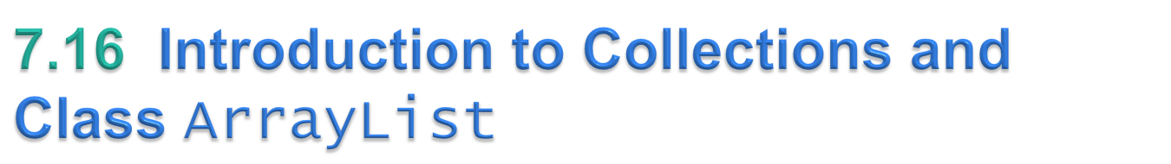
Java API provides several predefined data structures, called collections, used to store groups of related objects in memory.
  Each provides efficient methods that organize, store and retrieve your data without requiring knowledge of how the data is being stored.
  Reduce application-development time.
Arrays do not automatically change their size at execution time to accommodate additional elements.
ArrayList<T> (package java.util) can dynamically change its size to accommodate more elements.
  T is a placeholder for the type of element stored in the collection.
Classes with this kind of placeholder that can be used with any type are called generic classes.
© Copyright 1992-2015 by Pearson Education, Inc. All Rights Reserved.

Slide 13
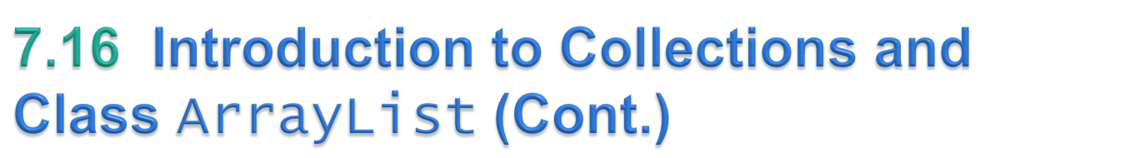
Figure 7.24 demonstrates some common ArrayList capabilities.
An ArrayList’s capacity indicates how many items it can hold without growing.
When the ArrayList grows, it must create a larger internal array and copy each element to the new array.
  This is a time-consuming operation. It would be inefficient for the ArrayList to grow each time an element is added.
  An ArrayList grows only when an element is added and the number of elements is equal to the capacity—i.e., there is no space for the new element.
© Copyright 1992-2015 by Pearson Education, Inc. All Rights Reserved.

Slide 14
Method add adds elements to the ArrayList.
  One-argument version appends its argument to the end of the ArrayList.
  Two-argument version inserts a new element at the specified position.
  Collection indices start at zero.
Method size returns the number of elements in the ArrayList.
Method get obtains the element at a specified index.
Method remove deletes an element with a specific value.
  An overloaded version of the method removes the element at the specified index.
Method contains determines if an item is in the ArrayList.
© Copyright 1992-2015 by Pearson Education, Inc. All Rights Reserved.

